Slide 1
Reinforcement Learning Monte Carlo Methods
Pablo Ruiz Ruiz
Deep Learning Intern Researcher @ Harvard University

Slide 2
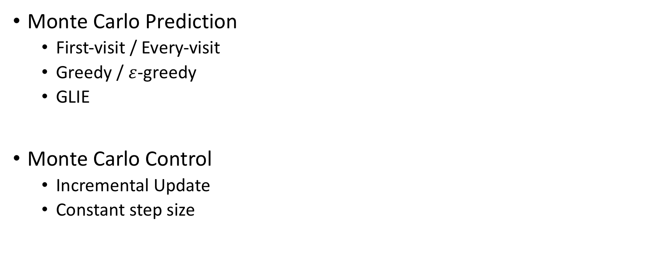
Index
Monte Carlo Prediction
First-visit / Every-visit
Greedy / $ε$-greedy
GLIE
Monte Carlo Control
Incremental Update
Constant step size

Slide 3
Monte Carlo Methods Monte Carlo Prediction
How good is my current policy?

Slide 4

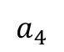
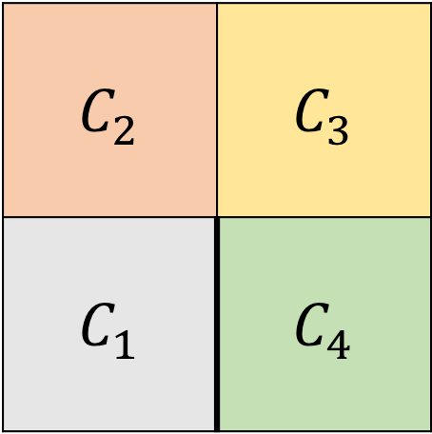
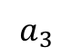
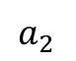
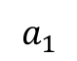
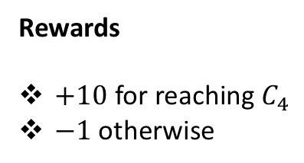
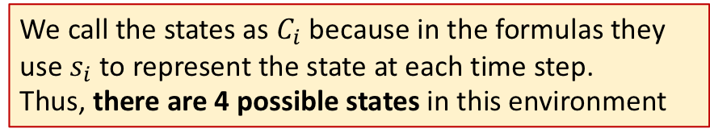
Environment Example
States
$$C_{2}$$ | $$C_{3}$$
$$C_{1}$$ | $$C_{4}$$
Actions
Rewards
$+10$ for reaching $C_{4}$
$−1$ otherwise
$$a_{1}$$
$$a_{2}$$
$$a_{3}$$
We call the states as $C_{i}$ because in the formulas they use $s_{i}$ to represent the state at each time step.
Thus, there are 4 possible states in this environment
$$a_{4}$$
Agent
Notes:
We call the states as $C_{i}$ because in the formulas they use $s_{i}$ to represent the state at each time step. But we want to make clear that there are 4 possible states in this environment

Slide 5
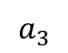
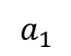
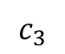
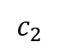
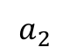
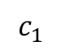
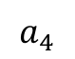
Environment Example
Table of values and Counter Table
$$a_{1}$$
$$a_{2}$$
$$a_{3}$$
$$a_{4}$$
$$c_{1}$$
$$c_{2}$$
$$c_{3}$$
X represents that if the agent takes that action, it will remain in the same cell in the next state
The Table of values is trying to answer the natural question:
which action is the best one at each state?
Counter Table is keeping track of how many time each state has been visited

Slide 6
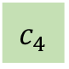
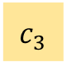
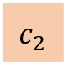
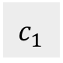
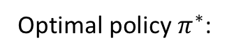
Environment Example
Optimal policy $π^{∗}$:
$$c_{1}$$
$$c_{2}$$
$$c_{3}$$
$$c_{4}$$
The agent has to find this policy by interacting with the environment
Notes:
We call the states as $C_{i}$ because in the formulas they use $s_{i}$ to represent the state at each time step. But we want to make clear that there are 4 possible states in this environment
X represents that if the agent takes that action, it will remain in the same cell in the next state

Slide 7
Monte Carlo Methods Monte Carlo Prediction

Slide 8
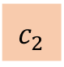
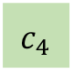
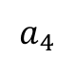
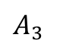
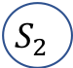
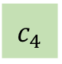
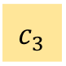
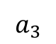
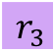
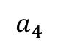
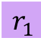
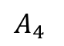
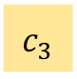
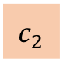
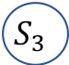
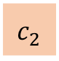
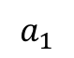
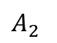
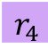
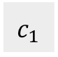
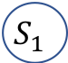
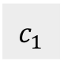
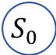
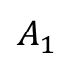
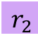
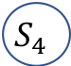
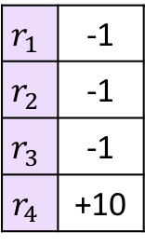
Monte Carlo Prediction
How do we update the table?
Episode 1:
Monte Carlo Methods run ENTIRE episodes
$$a_{1}$$
$$a_{4}$$
$$a_{3}$$
$$a_{4}$$
$$c_{1}$$
$$c_{2}$$
$$c_{2}$$
$$c_{3}$$
$$c_{4}$$
$$c_{4}$$
$$r_{4}$$
$$S_{4}$$
Rewards
$$A_{4}$$
$$c_{3}$$
$$S_{3}$$
$$r_{1}$$ | -1
$$r_{2}$$ | -1
$$r_{3}$$ | -1
$$r_{4}$$ | +10
$$r_{3}$$
$$A_{3}$$
$$c_{2}$$
$$S_{1}$$
$$A_{2}$$
$$S_{2}$$
$$r_{1}$$
$$r_{2}$$
$$A_{1}$$
$$c_{1}$$
$$S_{0}$$

Slide 9
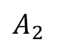
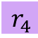
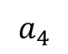



































Monte Carlo Prediction
Table of values
How do we update the table?
Cumulative Return
$$a_{1}$$
$$a_{2}$$
$$a_{3}$$
$$a_{4}$$
$$c_{4}$$
$$G\left(S_{2}\right)=G_{2}=r_{3}+r_{4}=−1+10=9$$
$$S_{4}$$
$$c_{1}$$
 |  | +8
$$r_{4}$$
$$A_{4}$$
$$c_{2}$$
$$c_{3}$$
$$r_{3}$$
$$S_{3}$$
$$c_{3}$$
$$A_{3}$$
$$c_{2}$$
$$S_{1}$$
$$A_{2}$$
$$S_{2}$$
$$r_{1}$$
$$r_{2}$$
$$A_{1}$$
Counter Table $N\left(s,a\right)$
$$Q\left(c_{2},a_{3}\right)$$
$$c_{1}$$
$$S_{0}$$
$$a_{1}$$
$$a_{2}$$
$$a_{3}$$
$$a_{4}$$
Rewards
$$c_{1}$$
 |  | +1
Update Rule: $Q\left(c_{2},a_{3}\right)$ = $r_{2}+G_{2}=−1+9=8$
$$r_{1}$$ | -1
$$r_{2}$$ | -1
$$r_{3}$$ | -1
$$r_{4}$$ | +10
$$c_{2}$$
$$N\left(c_{2},a_{3}\right)$$
$$c_{3}$$
General Update Rule: $Q\left(s_{t},a_{t+1}\right)$ = $r_{t+1}+G_{t+1}$

Slide 10

Monte Carlo Prediction
Table of values
How do we update the table?
$$a_{1}$$
$$a_{2}$$
$$a_{3}$$
$$a_{4}$$
$$c_{4}$$
$$G\left(S_{2},A_{3}\right)=r_{4}=10$$
$$S_{4}$$
$$c_{1}$$
 |  | +8 | +9
$$r_{4}$$
$$A_{4}$$
$$c_{2}$$
$$c_{3}$$
$$r_{3}$$
$$S_{3}$$
$$c_{3}$$
$$A_{3}$$
$$c_{2}$$
$$S_{1}$$
$$A_{2}$$
$$S_{2}$$
$$r_{1}$$
$$r_{2}$$
$$A_{1}$$
Counter Table $N\left(s,a\right)$
$$c_{1}$$
$$S_{0}$$
$$a_{1}$$
$$a_{2}$$
$$a_{3}$$
$$a_{4}$$
 |  | +1 | +1
This was just 1 episode
Let’s take a look at another episode

Slide 11























Monte Carlo Prediction
Episode 2:
Monte Carlo Methods run ENTIRE episodes
$$a_{4}$$
$$a_{1}$$
$$a_{3}$$
$$a_{4}$$
$$a_{2}$$
$$c_{1}$$
$$c_{1}$$
$$c_{2}$$
$$c_{2}$$
$$c_{3}$$
$$c_{4}$$
$$c_{4}$$
$$r_{5}$$
$$S_{5}$$
Rewards
$$A_{5}$$
$$c_{3}$$
$$S_{4}$$
$$r_{1}$$ | -1
$$r_{2}$$ | -1
$$r_{3}$$ | -1
$$r_{4}$$ | -1
$$r_{5}$$ | +10
$$r_{4}$$
$$A_{4}$$
$$c_{2}$$
$$S_{2}$$
$$A_{3}$$
$$S_{3}$$
$$r_{2}$$
$$r_{3}$$
$$A_{2}$$
$$c_{1}$$
$$S_{0}$$
$$A_{1}$$
$$S_{1}$$
$$r_{1}$$

Slide 12




































Monte Carlo Prediction
Table start with the values of previous episodes
Table of values
How do we update the table?
$$a_{1}$$
$$a_{2}$$
$$a_{3}$$
$$a_{4}$$
$$G\left(S_{3}\right)=G_{3}=r_{4}+r_{5}=−1+10=9$$
$$c_{4}$$
$$r_{5}$$
$$S_{5}$$
$$c_{1}$$
+8 |  | +8 | +9
$$A_{5}$$
$$c_{2}$$
$$c_{3}$$
$$r_{4}$$
$$S_{4}$$
$$c_{3}$$
$$A_{4}$$
$$c_{2}$$
$$S_{2}$$
$$A_{3}$$
$$S_{3}$$
$$r_{2}$$
$$r_{3}$$
$$A_{2}$$
Counter Table $N\left(s,a\right)$
$$c_{1}$$
$$A_{1}$$
$$Q\left(c_{2},a_{3}\right)$$
$$S_{0}$$
$$r_{1}$$
$$S_{1}$$
$$a_{1}$$
$$a_{2}$$
$$a_{3}$$
$$a_{4}$$
Rewards
$$c_{1}$$
+1 |  | +1 | +1
Update Rule: $Q\left(c_{2},a_{1}\right)$ =${ r}_{3}+G_{3}=−1+9=8$
$$r_{1}$$ | -1
$$r_{2}$$ | -1
$$r_{3}$$ | -1
$$r_{4}$$ | +10
$$c_{2}$$
$$c_{3}$$

Slide 13


Monte Carlo Prediction
Table start with the values of previous episodes
Table of values
How do we update the table?
$$a_{1}$$
$$a_{2}$$
$$a_{3}$$
$$a_{4}$$
$$G\left(S_{3}\right)=+r_{5}=+10$$
$$c_{4}$$
$$r_{5}$$
$$S_{5}$$
$$c_{1}$$
+8 |  | +8 | +9
$$A_{5}$$
$$c_{2}$$
$$c_{3}$$
$$r_{4}$$
$$S_{4}$$
$$c_{3}$$
$$A_{4}$$
$$c_{2}$$
$$S_{2}$$
$$A_{3}$$
$$S_{3}$$
$$r_{2}$$
$$r_{3}$$
$$A_{2}$$
Counter Table $N\left(s,a\right)$
$$c_{1}$$
$$A_{1}$$
$$Q\left(c_{2},a_{3}\right)$$
$$S_{0}$$
$$r_{1}$$
$$S_{1}$$
$$a_{1}$$
$$a_{2}$$
$$a_{3}$$
$$a_{4}$$
$$c_{1}$$
+1 |  | +1 | +1
Update Rule: $Q\left(c_{2},a_{1}\right)$ = $r_{3}+G_{3}=−1+9=8$
$$c_{2}$$
$$c_{3}$$
WHAT DO WE DO NOW?

Slide 14
Monte Carlo Methods First-Visit vs Every-Visit

Slide 15
Monte Carlo First Visit
Table start with the values of previous episodes
Table of values
How do we update the table?
$$a_{1}$$
$$a_{2}$$
$$a_{3}$$
$$a_{4}$$
$$G\left(S_{3}\right)=+r_{5}=+10$$
$$c_{4}$$
$$r_{5}$$
$$S_{5}$$
$$c_{1}$$
+8 |  | +8 | +9
$$A_{5}$$
$$c_{2}$$
$$c_{3}$$
$$r_{4}$$
$$S_{4}$$
$$c_{3}$$
$$A_{4}$$
$$c_{2}$$
$$S_{2}$$
$$A_{3}$$
$$S_{3}$$
$$r_{2}$$
$$r_{3}$$
$$A_{2}$$
Counter Table $N\left(s,a\right)$
$$c_{1}$$
$$S_{0}$$
$$A_{1}$$
$$S_{1}$$
$$r_{1}$$
$$a_{1}$$
$$a_{2}$$
$$a_{3}$$
$$a_{4}$$
$$c_{1}$$
+1 |  | +1 | +1
$$c_{2}$$
$$c_{3}$$

Slide 17
Monte Carlo First Visit
Table start with the values of previous episodes
Table of values
How do we update the table?
$$a_{1}$$
$$a_{2}$$
$$a_{3}$$
$$a_{4}$$
$$G\left(S_{3}\right)=+r_{5}=+10$$
$$c_{4}$$
$$r_{5}$$
$$S_{5}$$
$$c_{1}$$
+8 |  | +8 | +9+9=18
$$A_{5}$$
$$c_{2}$$
$$c_{3}$$
$$r_{4}$$
$$S_{4}$$
$$c_{3}$$
$$A_{4}$$
$$c_{2}$$
$$S_{2}$$
$$A_{3}$$
$$S_{3}$$
$$r_{2}$$
$$r_{3}$$
$$A_{2}$$
Counter Table $N\left(s,a\right)$
$$c_{1}$$
$$S_{0}$$
$$A_{1}$$
$$S_{1}$$
$$r_{1}$$
$$a_{1}$$
$$a_{2}$$
$$a_{3}$$
$$a_{4}$$
$$c_{1}$$
+1 |  | +1 | +1+1 = 2
$$c_{2}$$
$$c_{3}$$

Slide 18

NOTE 1
In Reinforcement Learning, one of the fundamental concepts are the value functions.
The action-value functions, $q_{π }\left(s,a\right)$, are the ones used for the control problem.
$q_{π }\left(s,a\right)$ is the expected return of taking a particular action in a particular state, and then follow the current policy $π$
That’s why the value table commonly receives the name of Q-Table

Slide 19

NOTE 2
$Q\left(s,a\right)$
After running all the episodes, we end up with a final picture for our Q-Table. We have been all the time following a given policy, (which was acting randomly), that tells the agent what to do at each particular state.
So the only information we have from this process is to know how good is the policy we are following, how good is to act random at every state
+5 | +4 | +2 | +4
+7 | +5 | +8 + 7.8 | +9
+10 | +7 | +8 | +8

Slide 20
Monte Carlo Methods Monte Carlo Control
Which is the best policy?

Slide 21















NOTE 3
$Q\left(s,a\right)$
+7 | +6 | +5 | +6
+8 | +7 | +8 | +9
+10 | +7 | +8 | +8
The resulting Q-Table could be used to find a better policy that the one we have been following. By taking the maximum of each row, we know which action is the best one to make at each possible state.
$$π^{′}$$
Optimal policy $π^{∗}$:
$$c_{1}$$
$$a_{1}$$
$$c_{1}$$
$$a_{1}$$
What we are sure is that the new policy found is at least $π^{′}≥π$
$$c_{2}$$
$$a_{4}$$
$$c_{2}$$
$$a_{4}$$
We are constructing the policy that is greedy with respect to the Q-Table
$$c_{3}$$
$$a_{1}$$
$$c_{3}$$
$$a_{2}$$

Slide 22



Collect episode and populate
$Q−Table$
$$π^{′}←greedy(Q)$$
$$π←π^{′}$$

Slide 23
What is the problem with acting greedy? We do not ensure we visit every possible state Then, how can we be sure our policy is the best one?

Slide 24






$ε$-greedy
How do we choose the value of $ε$?
Select most likely the best action, but give space for exploration.
$ε$– probability to take other action
1-$ε$ – probability to act greedy
To construct a policy that is $ε$-greedy with respect to Q:
The probability of taking action $a$ in state $s$
$$π\left(a|s\right)=\left\{\begin{aligned}1−ε+\frac{ε}{\left|𝒜\left(s\right)\right|} if a=arg\max_{a^{′}}{Q\left(s,a^{′}\right)} \\ \frac{ε}{\left|𝒜\left(s\right)\right|} otherwise\end{aligned}\right.$$
Maximum action is given the remaining bulk of the probability
All non maximum actions are given the minimal probability of selection

Slide 25


Greedy in the Limit with Infinite Exploration
To assure convergence to the optimal policy, 2 conditions have to be met:
1 – Every $\left(s,a\right)$ pair is visited infinitely many time
2 – The policy converges to a policy that is greedy w.r.t. Q
To satisfy the condition, the most common schedule for $ε$ is $ε=\frac{1}{\#episode}$
1 – $ε$ allways positive
2 – $ε$ decays to zero

Slide 26
What can be improved in this method? Right now we are improving the table after all the episodes We need a way to update the values after each episode

Slide 27
Monte Carlo Methods Monte Carlo Control Incremental updates

Slide 28





Monte Carlo Control
$Q\left(s,a\right)$
How do we update the table?
Suppose episode X
$$a_{1}$$
$$a_{2}$$
$$a_{3}$$
$$a_{4}$$
$$c_{4}$$
$$G\left(S_{2}\right)=G_{2}=r_{3}+r_{4}+r_{5}+r_{6}=−1−1−1+10=7$$
$$S_{6}$$
$$c_{1}$$
+5 | +4 | +2 | +4
+7 | +5 | +8 + 7.8 | +9
+10 | +7 | +8 | +8
$$r_{4}$$
$$A_{4}$$
$$c_{2}$$
$$c_{3}$$
$$r_{3}$$
$$S_{3}$$
$$c_{3}$$
$$A_{3}$$
$$c_{2}$$
$$S_{1}$$
$$A_{2}$$
$$S_{2}$$
$$r_{1}$$
$$r_{2}$$
$$A_{1}$$
$$Q\left(c_{2},a_{3}\right)$$
$N\left(s,a\right)$
$$c_{1}$$
$$S_{0}$$
$$a_{1}$$
$$a_{2}$$
$$a_{3}$$
$$a_{4}$$
$$c_{1}$$
+3 | +4 | +5 | +4
+4 | +3 | +4+1=+5 | +4
+2 | +2 | +1 | +2
Update Rule: $Q\left(c_{2},a_{3}\right)$ = $Q\left(c_{2},a_{3}\right)+\frac{1}{N\left(c_{2},a_{3}\right)}\left(G_{2}−Q\left(c_{2},a_{3}\right)\right)=8+\frac{1}{5}\left(7−8\right)=7.8$
$$c_{2}$$
$$c_{3}$$
General Update Rule: $Q\left(s,a\right)$ = $Q\left(s,a\right)+\frac{1}{N\left(s,a\right)}\left(G_{t}−Q\left(s,a\right)\right)$ = Current + step size * (expected – current)

Slide 29



Monte Carlo Control
$Q\left(s,a\right)$
How do we update the table?
Suppose episode X
$$a_{1}$$
$$a_{2}$$
$$a_{3}$$
$$a_{4}$$
$$G_{3}=+r_{4}+r_{5}+r_{6}=−1−1+10=8$$
$$c_{4}$$
$$r_{4}$$
$$S_{6}$$
$$c_{1}$$
+5 | +4 | +2 | +4
+7 | +5 | +7.8 | +9 +8.8
+10 | +7 | +8 | +8
$$A_{4}$$
$$c_{2}$$
$$c_{3}$$
$$r_{3}$$
$$S_{3}$$
$$c_{3}$$
$$A_{3}$$
$$c_{2}$$
$$S_{1}$$
$$A_{2}$$
$$S_{2}$$
$$r_{1}$$
$$r_{2}$$
$$A_{1}$$
$$Q\left(c_{2},a_{4}\right)$$
$N\left(s,a\right)$
$$c_{1}$$
$$S_{0}$$
$$a_{1}$$
$$a_{2}$$
$$a_{3}$$
$$a_{4}$$
$$c_{1}$$
+3 | +4 | +5 | +4
+4 | +3 | +5 | +4 +5
+2 | +2 | +1 | +2
$$c_{2}$$
$$c_{3}$$
$Q\left(c_{2},a_{4}\right)$ = $Q\left(c_{2},a_{4}\right)+\frac{1}{N\left(c_{2},a_{4}\right)}\left(G_{2}−Q\left(c_{2},a_{4}\right)\right)=9+\frac{1}{5}\left(8−9\right)=8.8$

Slide 30

What can be improved in this method? $\frac{1}{N\left(s,a\right)}$ will be high at the beginning and get smaller with time This is undesired, we want last information to be indeed more important

Slide 31

Monte Carlo Methods Monte Carlo Control Constant Step Size $α$

Slide 32

General Update Rule: $Q\left(s,a\right)$ = $Q\left(s,a\right)+\frac{1}{N\left(s,a\right)}\left(G_{t}−Q\left(s,a\right)\right)$ = Current + step size * (expected – current)
General Update Rule: $Q\left(s,a\right)$ = $Q\left(s,a\right)+α\left(G_{t}−Q\left(s,a\right)\right)$ = Current + fix step size * (expected – current)
Coding example of Monte Carlo Prediction playing Blackjack
Coding example of Monte Carlo Control playing Blackjack

Slide 33


Recap of Monte Carlo Algorithms

